Slide 1
MIROW Data Quality Assurance
Meeting 12
September 1, 2021

Slide 2
Today’s Agenda
Welcome
Homework and Questions
Questions for the Workgroup
Upcoming Work

Slide 3

Office Hours!
Small Group Members + you
Available to discuss any questions or feedback you have
Totally optional

Slide 4
Upcoming Work

Slide 5

Developing the Pieces of the Guide
Vocabulary
Principles, Business Rules, Processes
Supporting Content

Slide 6
Little Detour!
High Level
Medium Level
Specific
Introduction
Fundamental Concepts
Principles & Business Rules
Processes
Implementation Considerations

Slide 7
Timeline
Summer 2021 (Jul - Sept 2021)
Workgroup Reviews: Business Rules, Processes, Fundamental Concepts, Implementation Considerations
Fall 2021 (Oct - Dec 2021)
First Workgroup Review of Full Guide
Winter 2022 (Jan - Mar 2022)
External Review
Spring 2022 (Apr - Jun 2022)
Copyediting
Publish
Internal Review
Graphic Design
Webinar

Slide 8
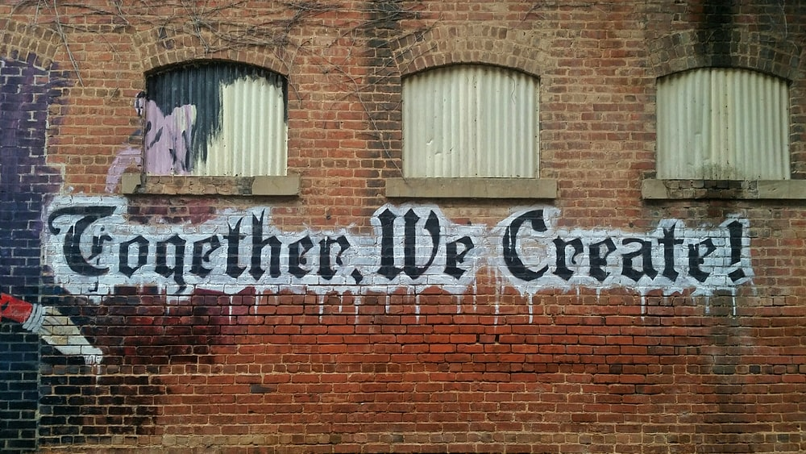

Slide 9
Questions for the Workgroup
Notes:
Elizabeth

Slide 10
Slides to Add (Remove this slide before mtg)
Characteristic definitions – present CDC as working definition; past definitions (AIRA ones)
PO profile becoming IIS-AO profile
Removing research from P02 – implied as part of PH
BRs with issues
BR813 – change in meaning as rewritten
Mandatory table – WS concern/confusion

Slide 11
Homework, Wrap-Up, and Questions
Notes:
Cindy

Slide 12
Slides to Add (Remove this slide before mtg)
[ add slide re: Process for reviewing Intro + FC]

Slide 13
Homework & Wrap Up
Homework: Business Rules
We would encourage you to block of 30-60 minutes per week
Due: Friday, August 13
Next Meeting: August
Will send a Doodle poll to find a date
Next meeting will focus on the next set of review material
Consider blocking time with office hours
Notes:
Cindy

Slide 14

Don’t forget office hours!
Notes:
Cindy

Slide 15

Questions
Notes:
Cindy

Slide 16
Thank you!
Please email or call with questions, comments, or funny jokes.
Beth Parilla bparilla@immregistries.org 202.552.5995
Notes:
Cindy

