Slide 1
Data at Rest (DAR) into the Validation Stage of Measurement & Improvement
May 13, 2026
Notes:
Valentin

Slide 2

Welcome to Today’s Townhall
If you experience any technical issues during the meeting, please contact “AIRA Standards & Analytics Team” via direct message in the Chat.
Notes:
Valentin
Introduce self, Damon, and Jody
Damon Ferlazzo is a Senior Technical Analyst who has been with AIRA more than five years, before that he served various roles within the Missouri Department of Health and Senior Services.
Jody Dial joined AIRA in July 2021 as a Program Manager. Prior to this role, Jody worked for the Kentucky Immunization Program for nine years, first as the AFIX/IQIP Coordinator and Immunization Registry Coordinator, and most recently as the Immunization Data and Surveillance Section Manager.

Slide 3
This meeting is being recorded and will be posted in the
AIRA repository
All phone lines
are muted
Notes:
Valentin

Slide 4
Technical Support
If you experience any technical issues during the meeting, please contact AIRA Standards & Analytics Team via direct message in the Chat.
Notes:
Valentin

Slide 5
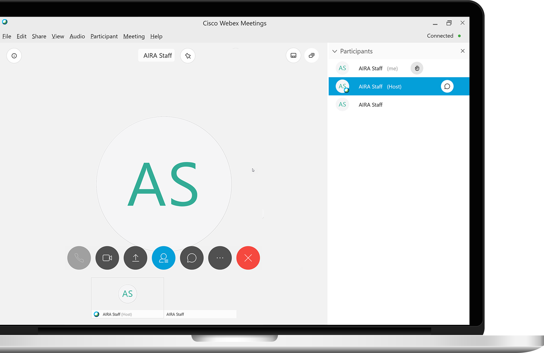
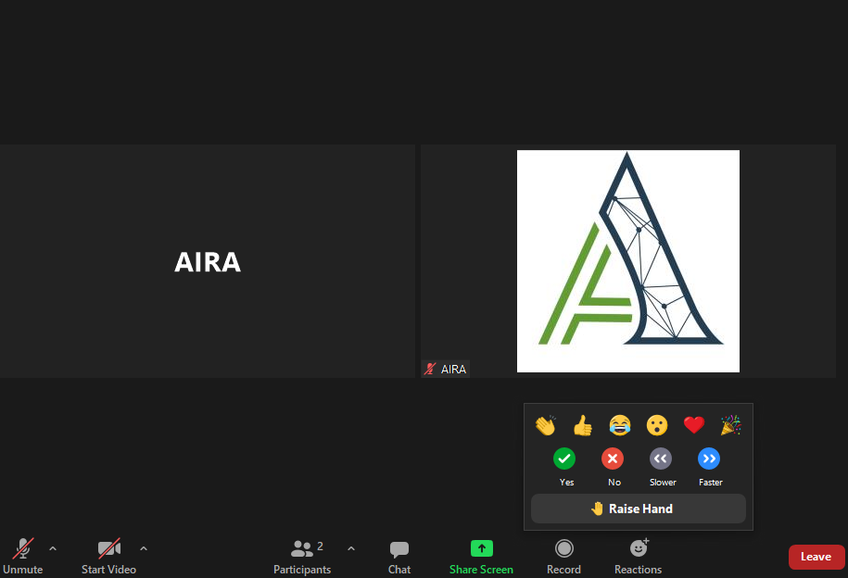
Questions
How do I ask a question?
There will be time allotted for Q&A following the presentations.
If you think of a question during the presentations:
Select the chat icon and type your question into the chat box.
Notes:
Valentin

Slide 6
Agenda
Welcome
Measurement & Improvement Overview
Background
Measures & Tests
Summary Data
Open Forum
Reminder for Community Comments
Notes:
Valentin

Slide 7
Questions?
Please hold questions until the open forum at the end of the presentation.
Notes:
Valentin

Slide 8
Measurement & Improvement Overview
Valentin Šoštarić , MACAW co-chair
Notes:
Valentin

Slide 9

Measurement and Improvement Initiative (M&I) – Overview
AIRA Measures and Tests IIS
IIS Make Improvements
The IIS Community Demonstrates Alignment
M&I began in 2015 in collaboration with CDC as an effort to:
  Test IIS alignment with standards
  Provide IIS with info and assistance to improve
All testing is conducted by AIRA through:
  Connecting with pre-production systems
  Analyzing deidentified data
  Sharing results via the Aggregate Analysis
  Reporting Tool (AART)
Notes:
Valentin
CDC began funding AIRA to conduct Measurement and Improvement in 2015. From the beginning, it was designed to do two things: 1) to test IIS alignment with standards, and 2) to provide IIS with information and assistance to improve. The community is engaged in developing and providing consensus on both the content areas for measurement and the test cases that are used to assess IIS. This iterative process happens throughout all of M&I.
The value of M&I for our IIS community is that:
It makes the successes of IIS standards alignment, visible​
Builds confidence in the IIS across other communities​
It allows us to prioritizes and accelerate essential improvements, as a community.
​
The value of M&I for our partners and stakeholders​ is that:
Providers & end users need to be able to trust the data they use
And public and private health partners need to be confident in data coming from IIS that is used for population-based assessment​.

Slide 10

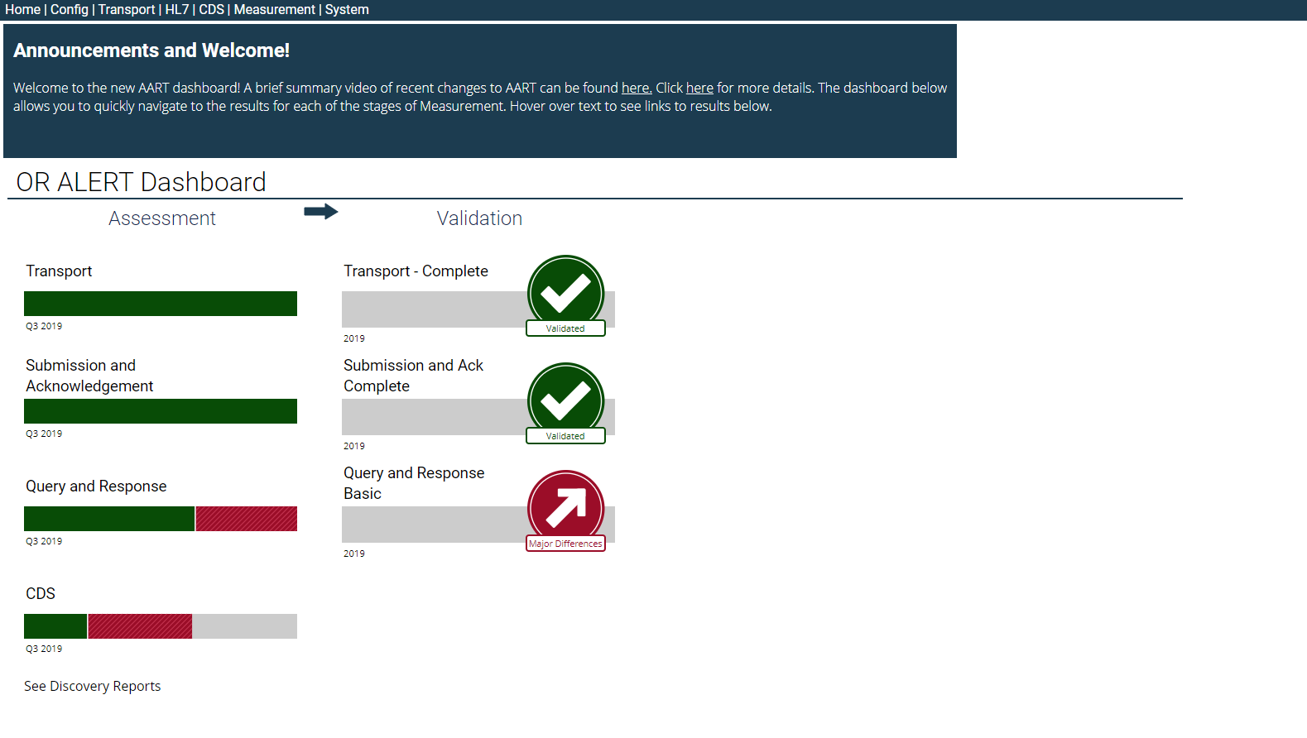
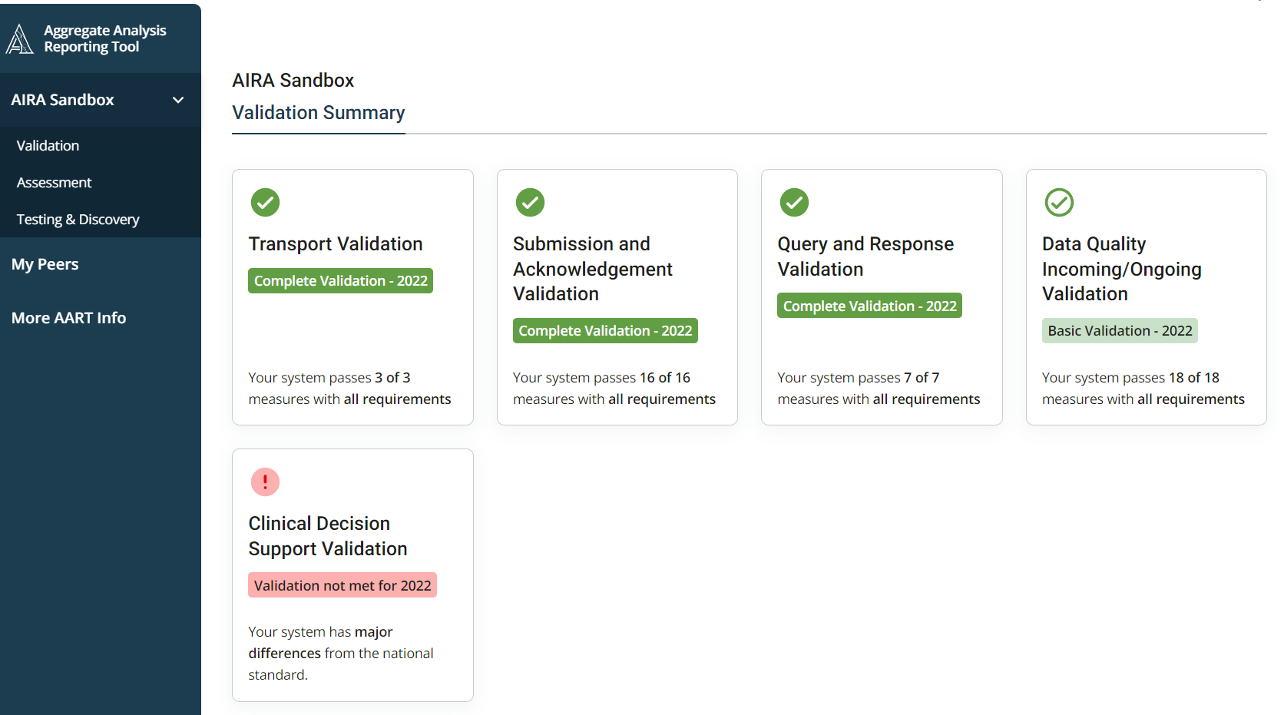
The AART Dashboard – Your Gateway To Data
Click to drill down to:
Measure results and information
Test case outcomes – expected and actual
Historical perspectives
Results from your peers who have shared their data and information
Notes:
Valentin
AIRA facilitates the testing process and connects their testing tool, the Aggregate Analysis Reporting Tool, more well known as AART, with IIS pre-production systems as well as analyzing deidentified data. AIRA’s team then reviews the reports for quality assurance and shares the results within the tool to the users.
The AART tool has everything you need to drill down and see your results.
You can find your test case results – both expected and actual…
Historical results over time, to chart your own improvement
Results of your peers who have shared their data and information
We encourage you select settings in AART to share broadly – with your peers, with your IIS vendor, and with your CDC partners. We’re all on the same team in supporting improvements and demonstrating progress.

Slide 11
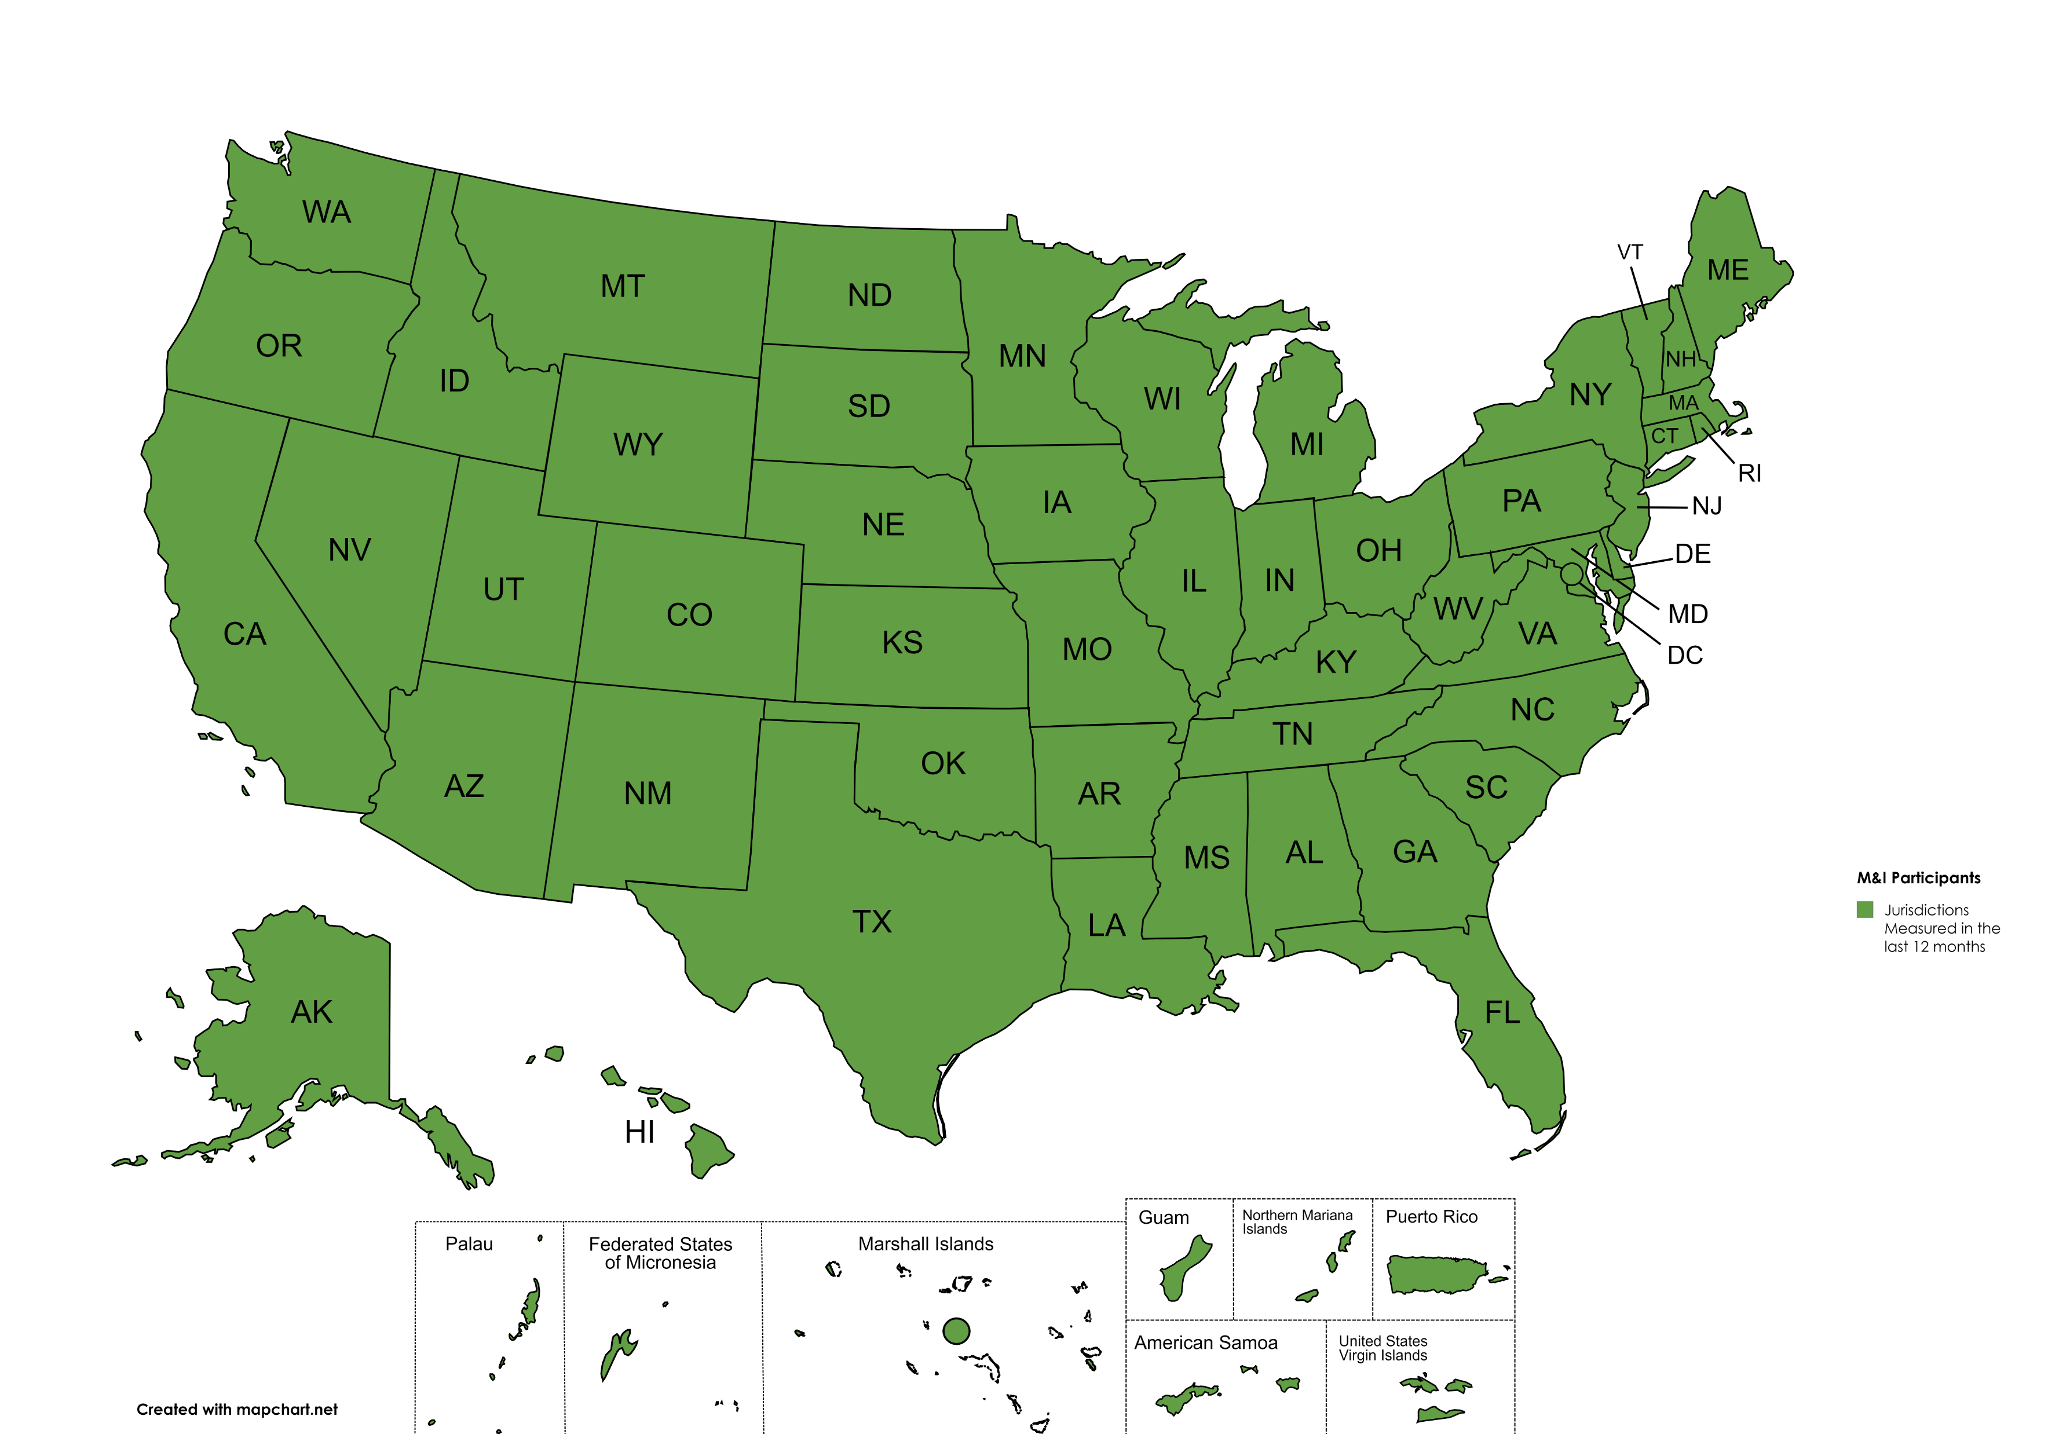
IIS Engagement In Voluntary Measurement
Community-wide participation is strong
Improvements in standardization across IIS are broadly recognized
61 out of 61 jurisdictions measured in the last 12 months
Notes:
Valentin
IIS participation in M&I is voluntary and strongly encouraged and supported by CDC, AIRA, and the broader community.
As displayed on this map, all 61 jurisdictions were voluntarily measured via AART in the last 12 months. Yes – this map means 100% of IIS are currently participating in M&I. This has been an ongoing effort for the last 10 years and we are very excited to reach 100% participation.
This strong level of participation leads to improvements in standardization across IIS – and jurisdictions have the option to share these improvements and be recognized through validation.

Slide 12

Who Supports The M&I Process Along With AIRA?
MACAW
CDC
The Measurement for Assessment and Certification Advisory Workgroup includes IIS, Immunization Program Managers, IIS Vendors, and Federal Partners
MACAW
CDC
Centers for Disease Control and Prevention are our funders, supporters, and collaborators
IIS, Imms Programs, Tech Partners
RESULTS
NIST
National Institute of Standards and Technology, who collaborate with AIRA to develop tooling to support measurement
IIS and Imms Programs analyze, plan, and implement systems. IIS tech partners support IIS and Imms Programs in planning and implementation
NIST
IIS/Imms
12
Notes:
Valentin
As I have mentioned in the previous slides, the M&I process is very much community-driven. MACAW, or the Measurement for Assessment and Certification Workgroup, is made up of IIS, Immunization Programs, IIS technology partners as well as federal partners like Indian Health Service, CDC, and NIST.
IIS and Immunization Programs do the heavy lifting of analysis, planning, and implementation, and of course IIS tech partners support IIS and Immunization Programs in these efforts.
The key point in all this is that the IIS community is very much engaged from the beginning, which really does two things:
It ensures that we’re measuring meaningful functions that move the needle on interoperability and data quality, and
It increases buy-in for improvement right out of the gate.

Slide 13
MACAW Members
Representing the Community Voice
Kevin Snow, Envision
(Co-Chair)
Valentin Sostaric, AZ
(Co-Chair)
Aaron Bieringer, MN
Alejandria Arias, CT
Dave McCormick, IN
Elise Balzer, Indian Health Svc.
Josh Hull, MI
Kevin Allen, TX
LaTreace Harris, CDC
Lauren Shaw, CDC
Janet Fath, CDC
Rob Snelick, NIST
Scott Benedict, Gainwell
Shannon Coleman, STChealth
Nathan Padgett, KY
Tina Lai, NYC
Notes:
Valentin
We would like to take a minute to recognize the MACAW members that continue to provide invaluable contribution to the M&I initiative and its progress, including the advancement of DAR.

Slide 14
M&I Stages
1
3
2
4
Testing and Discovery
Validation
Gather preliminary information on community alignment with standards
Acknowledge and publish results for IIS that are achieving alignment with community-selected measures and tests
Assessment
Conduct more formal testing to measure individual IIS systems using IIS community-selected measures and tests
Notes:
Valentin
M&I has three stages. READ SLIDE.
Validation is the ultimate goal. IIS that achieve validation are publicly recognized at AIRA’s National Meeting and receive digital badges to display their recognition. Additionally, AIRA publishes identifiable results in Validation Summary reports for each applicable content area. These can be accessed on AIRA’s repository at any time.

Slide 15
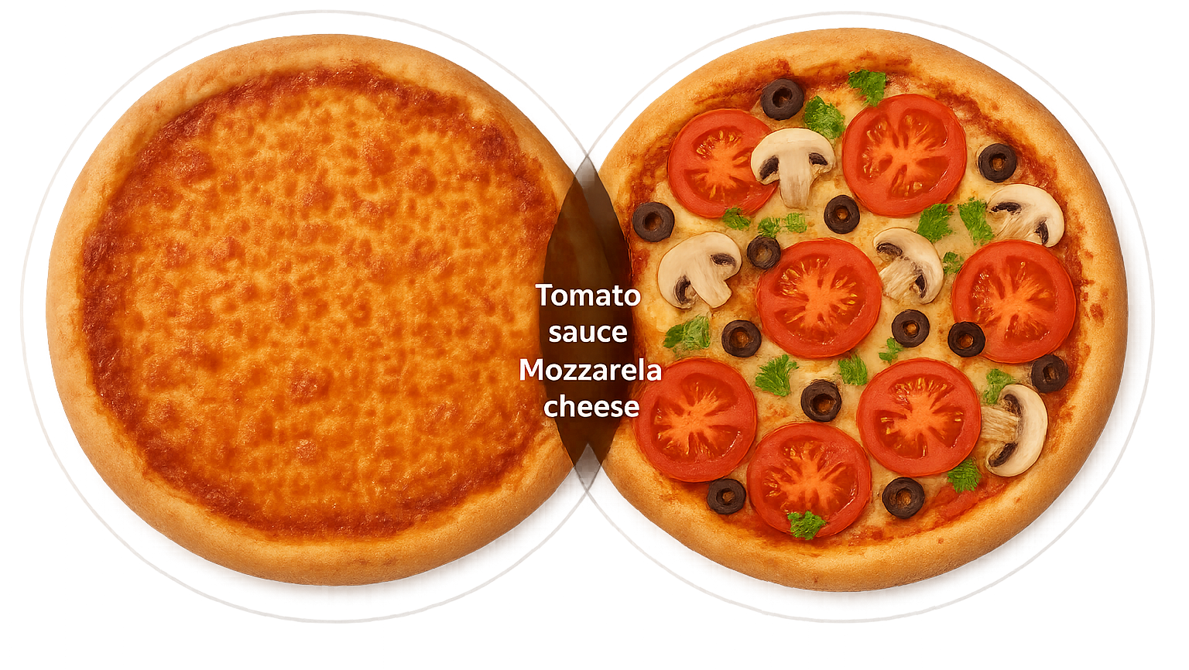
Levels of Validation
Complete= Essential + Helpful
Basic = Essential
(must also meet basic)
Graphic created using Microsoft Copilot
Notes:
Valentin
There are two levels of validation:
1) Basic- includes only essential measures to functionally meet the content area.
2) Complete- includes conformance to all measures approved for Validation. Additionally, all basic level measurements must also be met for an IIS to achieve complete validation.

Slide 16
M&I Measures
Development and Approval Process
Measures Created
Measures Refined, Updated
MACAW Prioritizes, Discusses and Develops Measures
Measures Shared
Measures Implemented
Comments are Compiled & Measures Updated
Measures are Shared with IIS Community for Review and Input
Testing Occurs and Results are Available in AART
1
4
2
3
Notes:
Valentin
Each stage of M&I requires certain steps to move the area along to the next. Here’s a quick reminder of the process we go through to create and approve new measures.
READ SLIDE
For the second step, MACAW typically hosts a three-week community comment period during which we disseminate the proposed measures and tests document to the broader community for review and host an interactive town hall. Which is why we are here today!

Slide 17

 | Pre-Measurement | Testing & Discovery | Assessment | Validation
Transport
Submission/Acknowledgment
Query/Response
Clinical Decision Support
Data Quality Incoming/Ongoing
Data at Rest
Patient Matching – HL7
Provider Participation
Onboarding
Patient Matching – Extract
Patient Saturation
Security
Vaccine Matching
Vaccine Saturation
Content Areas
Measurable Concepts
2027
Notes:
Valentin
Here is the landscape of progress since 2015. M&I’s content areas and measurable concepts are listed on the rows and M&I’s process stages across the columns. You can see five content areas have moved all the way through to Validation.
You can see we have several additional content areas that are in various stages of measurement. AIRA, CDC and MACAW engage the broader IIS community to prioritize areas for measurement. These prioritized measurable concepts and content areas advance at various intervals through the stages, each informed by community –led research, analysis, participation, and consensus.

Slide 18
DAR: Timeline
Measures Created
Measures Refined, Updated
MACAW Prioritizes, Discusses and Develops Measures
Measures Shared
Measures Implemented
Comments are Compiled & Measures Updated
Measures are Shared with IIS Community for Review and Input
Testing Occurs and Results are Available in AART
2019 -
Present
2027
May 2026
June 2026
Notes:
Valentin
Summarizes slide
Now I’ll turn the presentation over to Damon Ferlazzo who will take us through DAR

Slide 19
DAR: Background, Methods, Tests and Measures
Damon Ferlazzo, AIRA
Notes:
Damon

Slide 20
Topics to Discuss
Foundations
Methods
Measures & Tests
Recent Assessment Data
Notes:
Damon

Slide 21



What is Data at Rest - DAR?
Static data
  Patient and immunization data
  From any source
  Residing in production IIS database
  Available in User Interface and RSPs
Distinct from data “in transit” or “on the wire” (out of scope)
Notes:
Damon

Slide 22
DAR’s Dimensions of Data Quality
Notes:
Damon
Completeness – is the field populated with data or not
Validity – does the data make sense
Timeliness – how much time elapses between when an event occurs and when it’s recorded in the IIS

Slide 23
CDC’s IIS Functional Standards
Functional Standard B4.0: The IIS validates patient demographic and vaccination data.
  Guidance Statement B4.2: The IIS monitors data quality within the IIS in accordance with policies and procedures.
  Guidance Statement B4.4: The IIS delivers feedback and training to IIS partners and providers to ensure complete, timely, and accurate patient demographic and vaccination records.
  Guidance Statement B4.5: The IIS meets federal and jurisdictional data quality metrics.
23
Notes:
Damon

Slide 24

Published Material
November 2018
IIS Data Quality Practices - To Monitor and Evaluate Data at Rest
Includes measures for patients and vaccines
Source of DAR thresholds
  E.g., Address Completeness > 95%
https://repository.immregistries.org/resource/iis-data-quality-practices-to-monitor-and-evaluate-data-at-rest/
Notes:
Damon

Slide 25
Methods
Extract
Transform
Load
Analyze
Extracted from IIS production database
  Cohort: 0-2 years of age in the last calendar year
Transformed with the command line interface tool
  Detections are performed
Loaded into AART - Aggregate detections file (ADF)
Analyzed in qDAR
Published reports are available in
Note – No PII, small cell sizes or line-level data is shared with AIRA
Notes:
Damon
Deidentified patient and vaccine level data is extracted from IIS production database
Cohort: 0-2 years of age in the last calendar year
Data is transformed and aggregated using the command line interface tool
Detections are performed
Aggregate detections file (ADF) is uploaded into AART
Data is analyzed in qDAR
Reports are generated and published in AART and qDAR
Note – No PII or line-level data is shared with AIRA

Slide 26
Measures & Tests
Notes:
Damon

Slide 27
Completeness Measures Part 1
Approved Assessment Measure | Basic Level | Complete Level
1.01 - Patient first name is present in more than 99% of cases | X | X
1.02 - Patient middle name is present in more than 75% of cases |  | X
1.03 - Patient last name is present in more than 99% of cases | X | X
1.04 - Patient date of birth is present in more than 99% of cases | X | X
1.05 - Patient gender is present in more than 99% of cases | X | X
1.06 - Patient address street is present in more than 85% of cases | X | X
1.07 - Patient address city is present in more than 85% of cases | X | X
1.08 - Patient address state is present in more than 85% of cases | X | X
1.09 - Patient address ZIP code is present in more than 85% of cases | X | X
Notes:
Damon
Let’s quickly walk through each of the measures, their thresholds and which level of validation they are proposed to be assigned. You’ll see these measures and their proposed level of validation in another set of slides, so I’ll only summarize these.
Also, you can find these in our measures and test document in the repository: https://.immregistries.org/resource/aira-town-hall-data-at-rest-dar/
repository
Remember, we’d like to hear from you on our proposal, so please review this document and provide comments by June 3rd
Keep in mind you must meet all basic measures in order be validated at the complete level.
I’ll walk you through reading this table and then give you a moment to review.
The first measure is that the patient’s first name is present in more than 99% of cases - this measure is proposed to be part of both basic and complete validation.
The next measure is that patient’s middle name is present more than 75% of cases. This measure is only proposed to be a part of complete validation and not a part of basic.
Now I’ll pause a few seconds so you can read the remainder of the table.
[pauses for 15 seconds]
If you don’t remember these, don’t worry, you’ll see them in a few minutes. Also, they are in the measures and test document.

Slide 28
Completeness Measures Part 2
Approved Assessment Measure | Basic Level | Complete Level
1.10 - Patient complete address is present in more than 85% of cases | X | X
1.11 - Patient race is present in more than 95% of cases
1.12 - Patient ethnicity is present in more than 95% of cases
1.13 - Patient phone number is present in more than 90% of cases
1.14 - Patient email is present in more than 90% of cases
1.15 - Mother’s maiden name is present in more than 90% of cases
1.16 - Responsible person’s first name is present in more than 90% of cases |  | X
1.17 - Responsible person’s last name is present in more than 90% of cases |  | X
1.18 - Vaccine administration code is present in more than 99% of cases | X | X
Blank = Not Proposed to be Included in Validation
Remains in Assessment
Notes:
Damon
Now let’s review the second part of our completeness measures.
Note in this table that several measures are proposed to not advanced towards validation at this time.
I’ve highlighted these to remind everyone that the current proposal is that these won’t be evaluated for our validation program
Note that responsible person’s names are only included in the complete, or more advanced, stage of validation while the other measures in the table are proposed to be both basic and complete validation measures.
I’ll pause for a few seconds to let you review this table
[10 second pause]

Slide 29
Completeness Measures Part 3
Approved Assessment Measure | Basic Level | Complete Level
1.19 - Vaccine administration date is present in more than 99% of cases | X | X
1.20 - Vaccine information source (e.g., Admin/Historical Indicator) is present in more than 99% of cases | X | X
1.21 - Vaccine lot number is present in more than 99% of cases |  | X
1.22 - Vaccine lot expiration date is present in more than 99% of cases
1.23 - Vaccine eligibility code is present in more than 99% of cases
1.24 - Vaccine funding source is present in more than 99% of cases
Blank = Not Proposed to be Included in Validation
Notes:
Damon
Here’s our final set of completeness measures
Again, note that lot number’s presence is only part of complete validation and there are several items that are not proposed to be included in validation
I’ll pause for a few seconds to let you review this table
[10 second pause]

Slide 30
Validity Measures Part 1
Approved Assessment Measure | Basic Level | Complete Level
2.01 - Patients born on the first of the month do not exceed uniform distribution of birth dates of less than 4% of cases |  | X
2.02 - Patients born on the 15th of the month do not exceed uniform distribution of birth dates of less than 4% of cases |  | X
2.03 - Patients born on the last day of the month do not exceed uniform distribution of birth dates of less than 4% of cases |  | X
2.04 - Patient has more vaccinations than expected in less than 1% of cases | X | X
2.05 - Vaccine administration date is after vaccine lot expiration date in less than 1% of cases
2.06 - Vaccine administration date is before birth date in less than 1% of cases | X | X
2.07 - Vaccine administration dates on the first day of the month do not exceed normal distribution of administration dates of less than 4% of cases |  | X
Blank = Not Proposed to be Included in Validation
Notes:
Damon
Now we’ll take a look at the first set of validity measures
To ensure dummy date of births are not being used we expect to see less than 4% of births on the 1st, 15th, or last of the month. The date of birth validity measures are only a part of the complete validation level.
Note that we’ve exclude expired vaccination administration from our validation levels.
I’ll pause for a few seconds to let you review this table
[10 second pause]

Slide 31
Validity Measures Part 2
Approved Assessment Measure | Basic Level | Complete Level
2.08 - Vaccine administration dates on the 15th of the month do not exceed uniform distribution of administration dates of less than 4% of cases |  | X
2.09 - Vaccine administration dates on the last day of the month do not exceed uniform distribution of administration dates of less than 4% of cases |  | X
2.10 - Vaccine administration code was administered at an improbable age in less than 1% of cases |  | X
2.11 - Vaccine administration code is not specific for administered vaccination event in less than 1% of cases | X | X
2.12 - Vaccine lot number has an invalid prefix in less than 1% of cases |  | X
2.13 - Vaccine lot number has an invalid infix in less than 1% of cases |  | X
2.14 - Vaccine lot number has an invalid suffix in less than 1% of cases |  | X
Notes:
Damon
For our second set of validity measures note that for basic validation we expect to see not otherwise specified, or NOS, vaccine codes used for administered doses less than 1% of the time
All of these measures are part of the proposed complete validation level.
I’ll pause for a few seconds to let you review this table
[10 second pause]

Slide 32
Validity Measures Part 3
Approved Assessment Measure | Basic Level | Complete Level
2.15 - Vaccine lot number contains at least one invalid character in less than 1% of cases |  | X
2.16 - Vaccine lot number is too short in less than 1% of cases |  | X
2.17 - Vaccine administration code is unrecognized in less than 1% of cases | X | X
2.18 - Vaccine manufacturer is unrecognized in less than 1% of cases |  | X
2.19 - Vaccine administration route is unrecognized in less than 1% of cases |  | X
2.20 - Vaccine body site is unrecognized in less than 1% of cases |  | X
Notes:
Damon
This is our last set of validity measures.
Note that these are all proposed to be a part of the complete validation level
Also that using an unrecognized vaccine code is only permitted in less than 1% of cases is part of basic validation
I’ll pause for a few seconds to let you review this table
[10 second pause]

Slide 33
Timeliness Measure
Approved Assessment Measure | Basic Level | Complete Level
3.01 - Administered vaccination events are entered into the IIS within one calendar day from administration date in more than 95% of cases
Blank = Not Proposed to be Included in Validation
Notes:
Damon
Finally,
While we have a timeliness measure in assessment it’s not included in our validation proposal.

Slide 34


2025
Summary
Data
30 IIS = participated since 2023
25 IIS = participated in 2025
Basic
Complete
Notes:
Damon
Let’s quickly review IIS performance in 2025 for assessment measures and at what validation level they are proposed to be a part of.
To read this chart please note the outlined check mark are measures proposed to be in basic validation and the filled in check mark circle are measures proposed to be in complete validation. Next, you’ll see a bar chart the color on the left is green noting the number of IIS that passed a measure and the color on the right, red, is the number of IIS that did not meet a measure.
All participating IIS did well in most of these measures with the exception of middle name, race and ethnicity completeness measures
You can see that of the 24 IIS that participated in DAR last year, 13 met the 75% threshold for middle name and 11 did not. Remember that middle name completeness is a part of our proposal for only for complete validation.
Race and ethnicity completeness are not proposed to be a part of validation at this time. You can see that most participating IIS were not able to reach the threshold of more than 95% completeness

Slide 35
2025
Summary
Data
Basic
Complete
Notes:
Damon
Here’s how IIS performed in our next set of measures. You can see that for measures where a majority of IIS did not perform well, MACAW did not propose the measures to advance from Assessment to Validation.
I’ll pause a few seconds for you to review this graph.
[10 second pause]

Slide 36
2025
Summary
Data
Basic
Complete
Notes:
Damon
This graph is where we begin to look at validity measures. Note that administering doses at an improbable age less than 1% of the time is a part of complete but not basic validation.
I’ll pause a few seconds for you to review this graph.
[10 second pause]

Slide 37
2025
Summary
Data
Basic
Complete
Notes:
Damon
This is our final graph that covers the remainder of the validity measures and our timeliness measure.
Note that all these measures with check marks are proposed to be a part of the complete validation level.
You can see that a large number of IIS struggle to have vaccines into their system within one day.
I’ll pause a few seconds for you to review this graph.
[10 second pause]

Slide 38
What if we apply the current proposal to the 2025 Assessment Data?
  23 of 24 IIS would be validated at the basic level
  1 of 24 would be validated at the complete level
Notes:
Damon
After reviewing IIS performance for the last year, one question people might ask is what if DAR was in Validation last year, how many IIS would be recognized at the basic and complete levels?
Now let’s hear more questions and comments from the community.

Slide 39
Open Forum
Jody Dial
Notes:
Jody

Slide 40
Open Forum
How do I ask a question or make a comment?
Select the unmute icon and ask your question verbally.
Select the chat icon and type your question/comment into the chat box.
Select the reactions icon, select “Raise Hand,” and you will be called on.
Notes:
Jody
1 question that Jody will read:
Q: Where did these thresholds come from and how do we change them?
A: The thresholds came from the IIS Data Quality Practices - To Monitor and Evaluate Data at Rest from November 2018. Many of these of those come from external sources like the MIROW best practice documents and the CDC Data Quality Blueprint.
A: Traditionally, we can't change overall expectations of a measure within assessment without going to the community feedback process. We’d need a revised measures and test document for the assessment level and a townhall meeting. Then after a year we could discuss changing the thresholds. We encourage everyone to review the current proposal and submit comments on measures you believe have an unrealistic thresholds and propose a realistic threshold. Having community input on that is really valuable input for future MACAW discussions.
1 person from MACAW will ask a question
Kevin:
Q: Why is there no timeliness measure proposed to move into validation?
A: Unfortunately, 3 quarters of IIS that have participated in DAR did not meet the timeliness measure to have 95% of vaccine recorded within 1 day of administration. MACAW felt like there current threshold was too high and there was no enforcement mechanism that could be employed to force providers to submit their data in a timelier manner. Again, We encourage everyone to review the current proposal and submit comments on measures you believe have an unrealistic thresholds and propose a realistic threshold.

Slide 41
Wrap Up/Next Steps
Jody Dial
Notes:
Jody

Slide 42
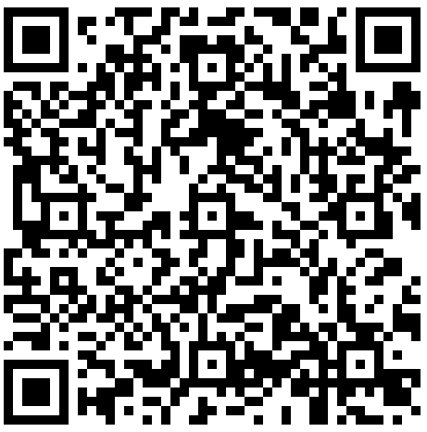
Community Review and Comments
Please review our Measures and Test Document for DAR at:
  repository.immregistries.
  org/resource/aira-town-
  hall-data-at-rest-dar
  Comments accepted through June 3rd
  Send to rsandtveit@immregistries.org
  All comments will receive responses
Notes:
Jody
Paste in the chat:
https://repository.immregistries.org/resource/aira-town-hall-data-at-rest-dar/

Slide 43
Thank you for joining us, for your input, and for your continued improvement work!
Jody Dial: jdial@immregistries.org
Damon Ferlazzo: dferlazzo@immregistries.org
Valentin Šoštarić: valentin.sostaric@azdhs.gov
Notes:
Jody

